Slide 1
المحاضرة العاشرة
The Inverse of Laplace
Transform
University of Technology
Materials Engineering Dept.
Ceramics & Construction Materials By

Slide 2
Definition
If the Laplace transform of the function f(t) is F(s)
L{ f (t)} = F (S)
The original function f(t) is called the inverse transform and will be denoted by L⁻¹ {F(s)}
f (t) = L⁻¹{F (s)}

Slide 3
f (t) = e^{−2t} t is a real variable f(t) is a real function | L Laplace Transform _{L}-1 Inverse Laplace Transform | F (s) = ¹ s + 2 s is complex variable F(s) is a complex valued function
Time Domain
Frequency Domain

Slide 4
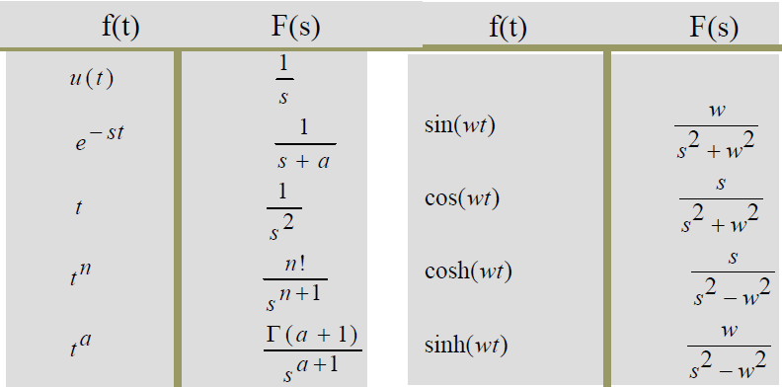
Transform Pairs:

Slide 5
L⁻¹{F (s) + G(s)}= L⁻¹{F (s)}+ L⁻¹{G(s)}
Linearity Property
First Shifting Property

Slide 6
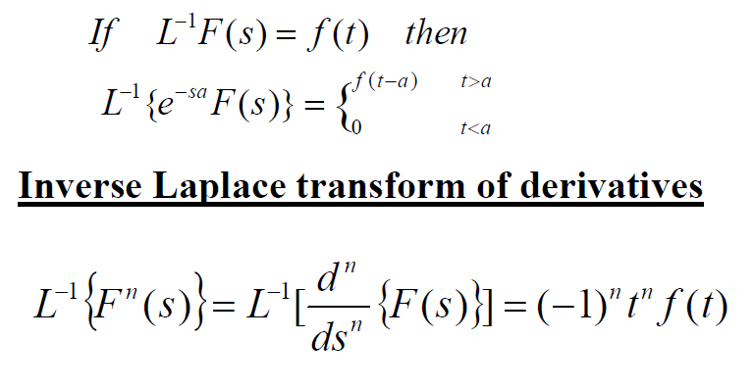
Second Shifting Property

Slide 7
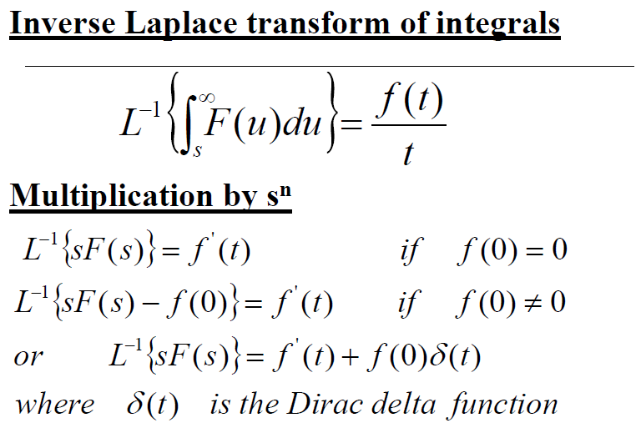

Slide 8
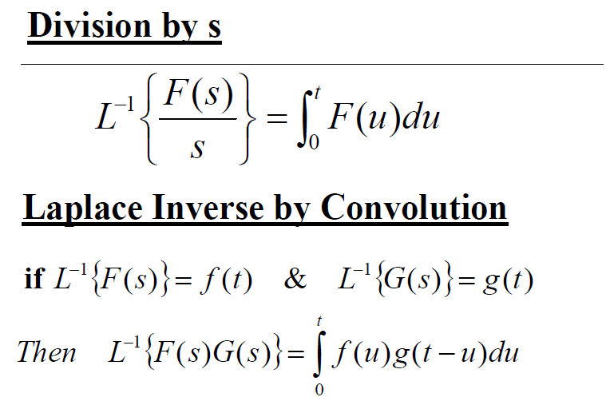

Slide 9
Inverse Laplace by Partial Fraction Expansion
We will consider three cases
distict poles
repeated poles
complex poles

Slide 10
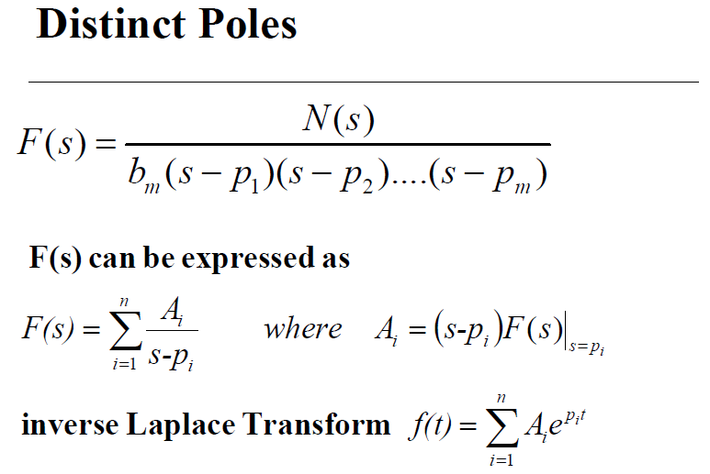

Slide 11
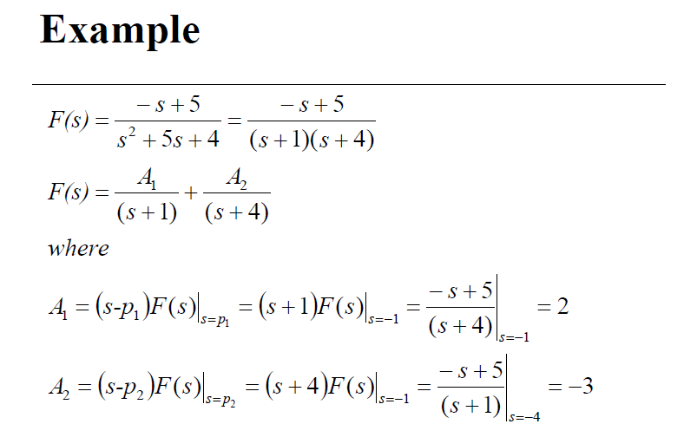

Slide 12
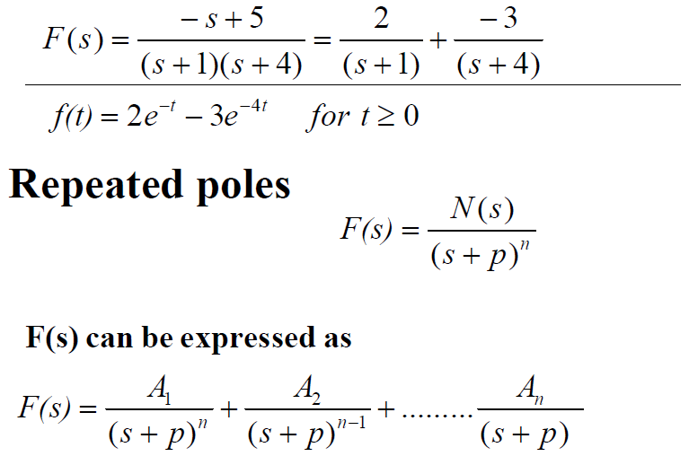

Slide 13
1. Chapra, Steven C., and Raymond P. Canale. Numerical methods for engineers. Vol. 2. New York: McGraw-Hill, 2012, p230.
2. Collins, George. "Fundamental numerical methods and data analysis.” Fundamental Numerical Methods and Data Analysis, by George Collins, II. (1990).
3.Dr. Kadhum Muttar, University of Technology ,Materials Engineering Dept.

